Slide 1
Data Exchange FHIR CMC August Testing Event
August 10 and 11

Slide 2
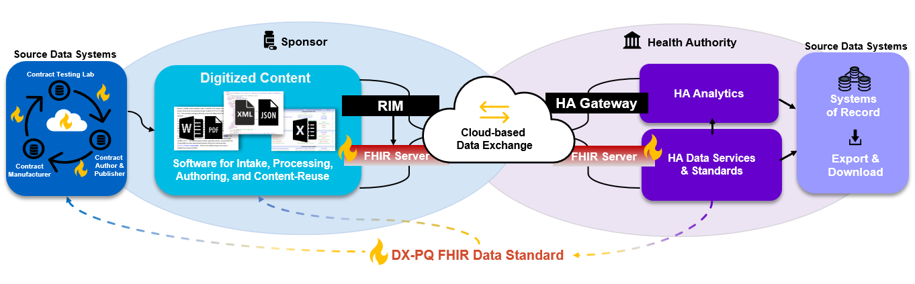
High level view of how a submission comes together

Slide 3
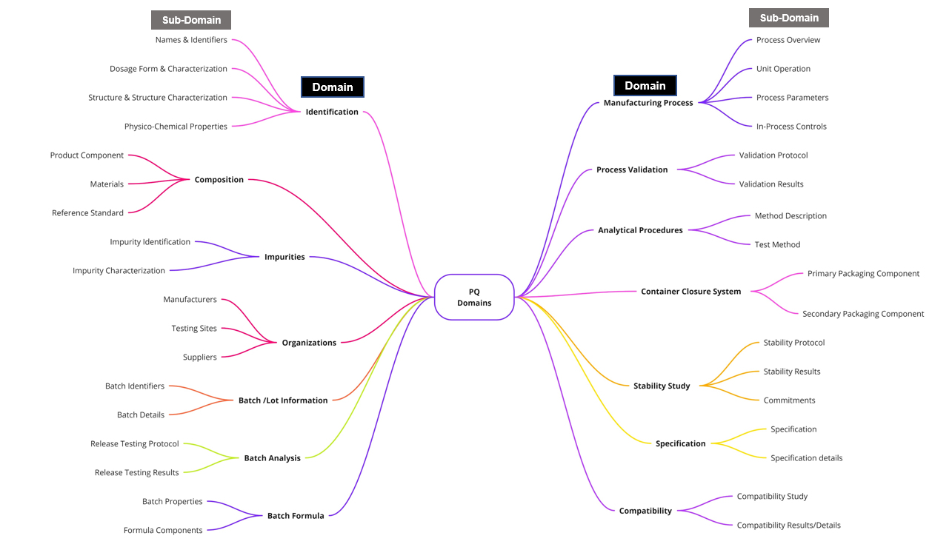
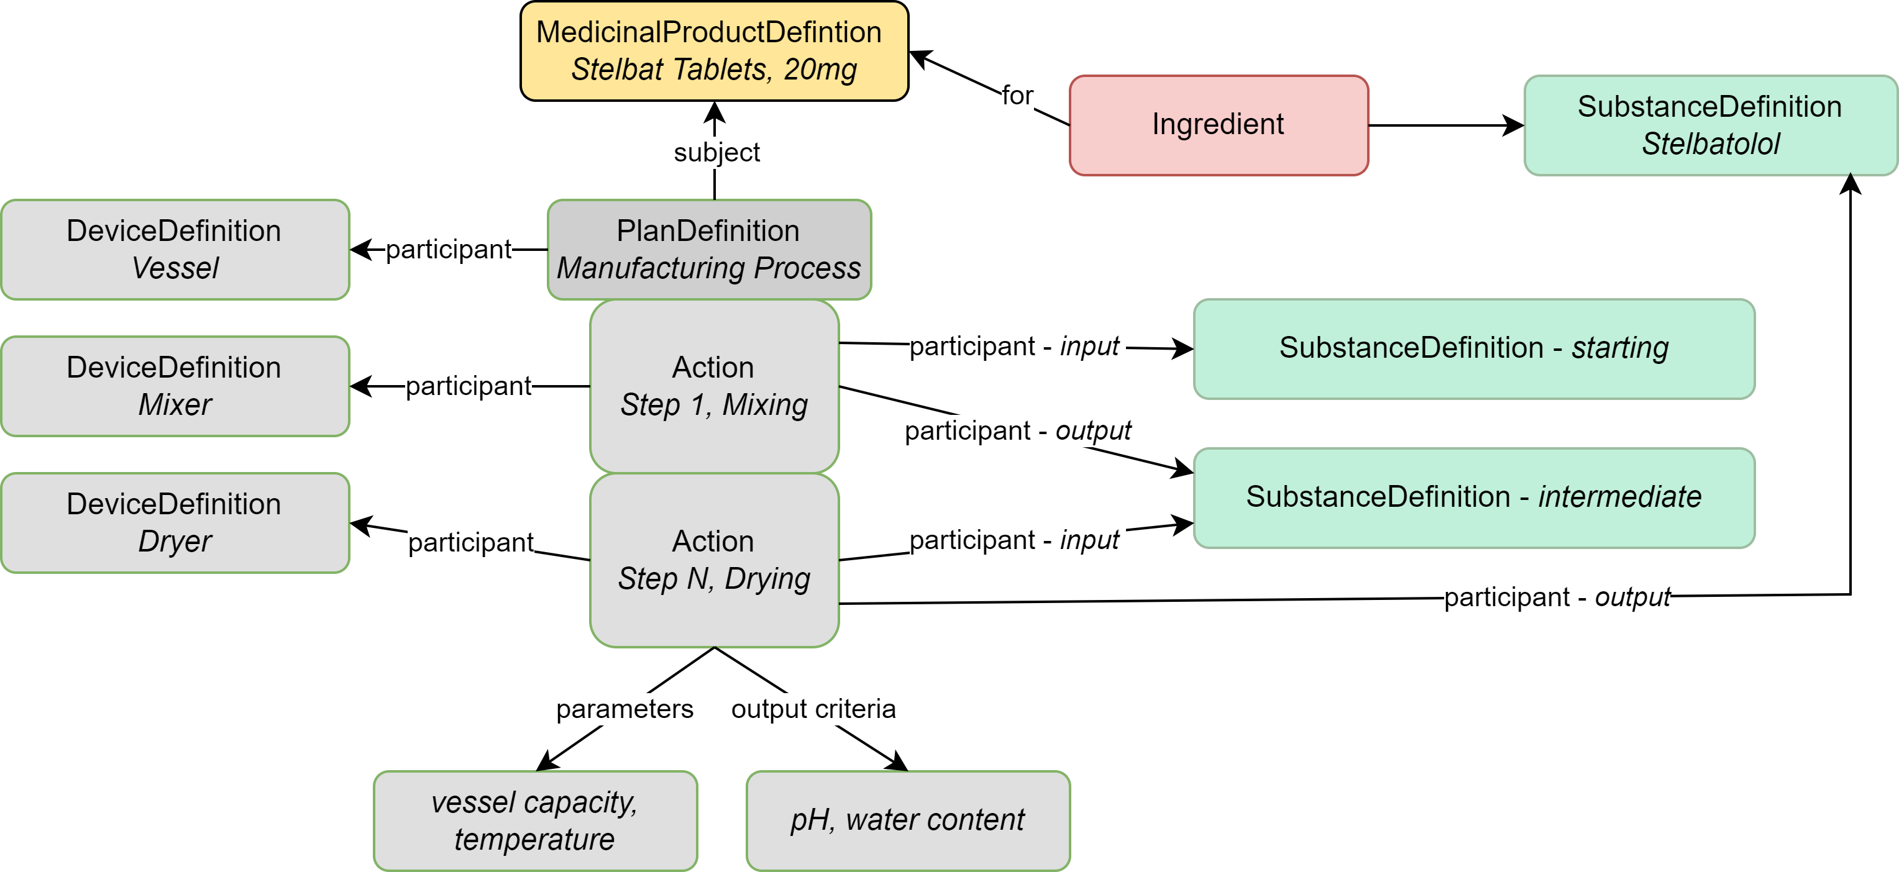
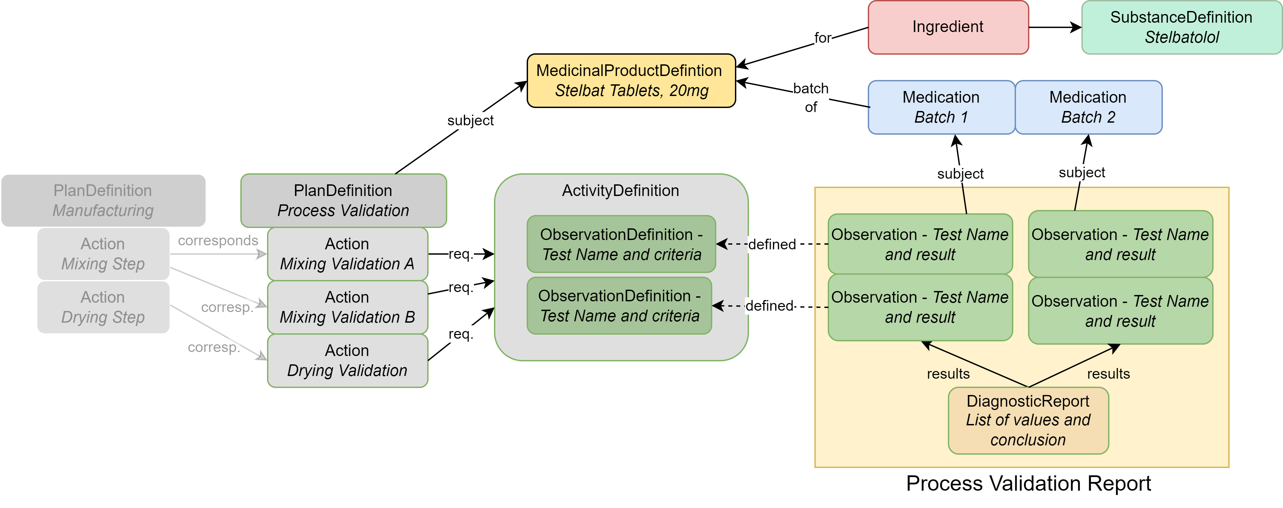
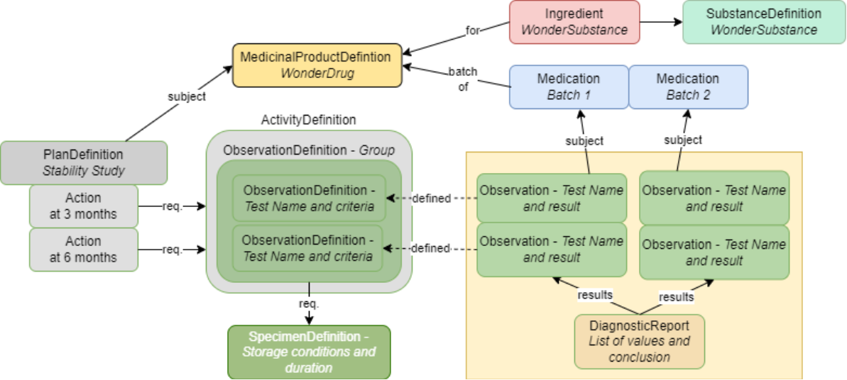
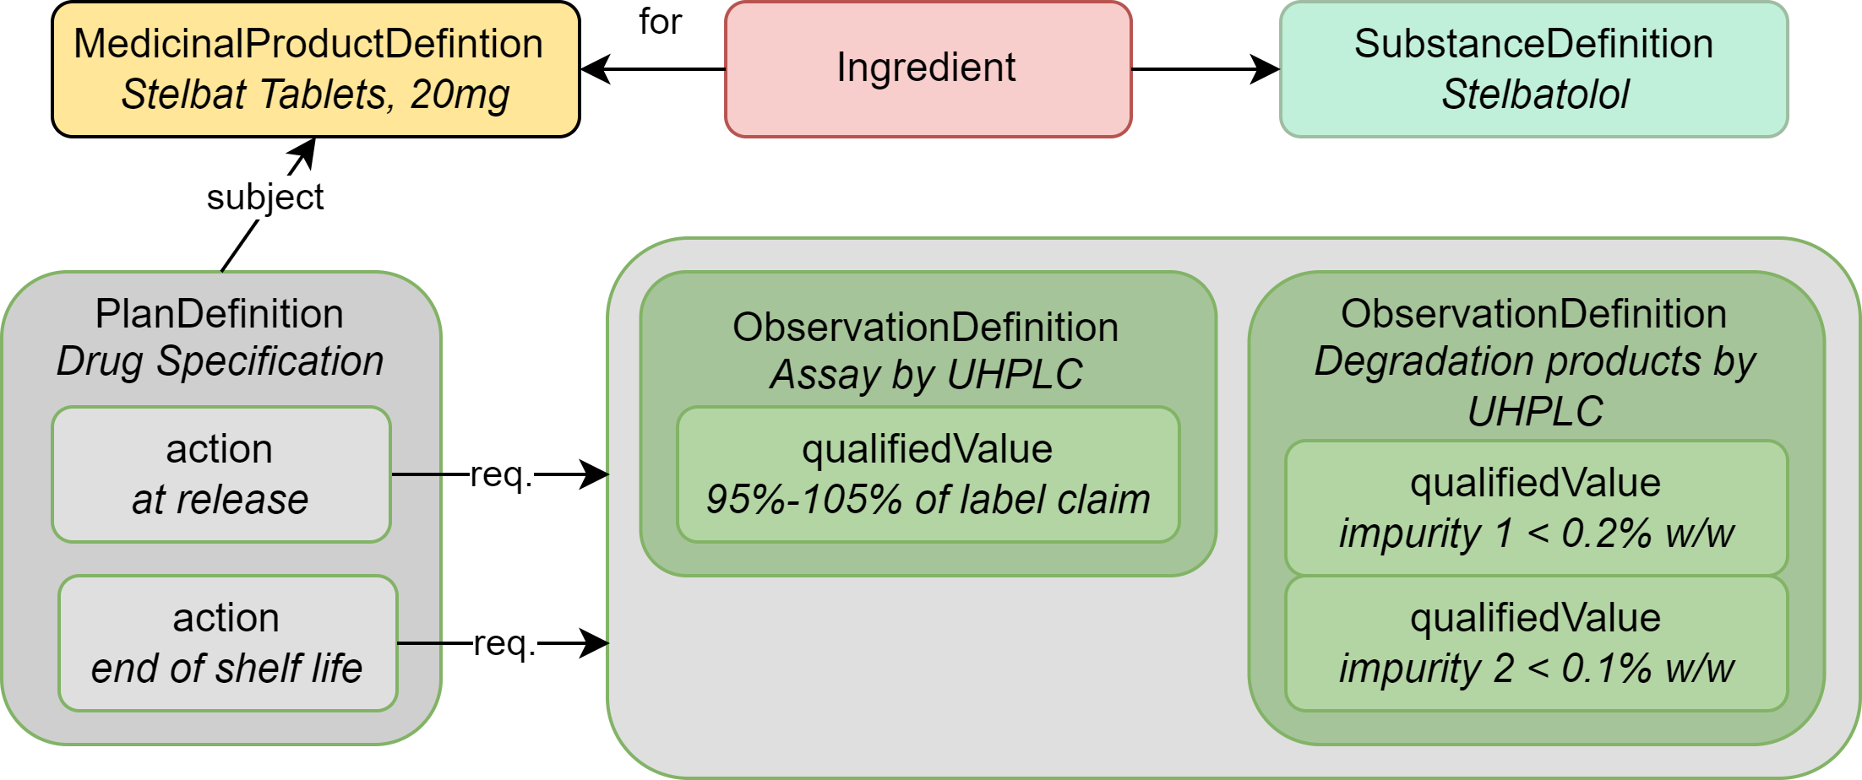
Full domain model and pre-fabricated profile template for each domain
3
4
Library of pre-fabricated / pre-populated structured templates
1
2

Slide 4
General questions for assessment of each profile template
Is the flow of information logical and fit for purpose?
Do the “blocks” in each model connect to one another appropriately? Are there sufficient connections across domain areas?
Are any components or key concepts associated with the domain area missing?
For example, if I am building a stability data package, do I have all of the requisite parts to be able to communicate all of the information needed?
Modality-specific concerns (mab, vaccine, gene therapy, ADC, etc.) are generally out of scope for the first draft of the IG, but can be noted for incorporation if possible
Global or regional considerations and requirements
Can the model fit multiple use cases as intended?
CMO → Sponsor
Sponsor → Health authority
Sponsor → Sponsor
Sponsor [Dept A → Dept B]

Slide 5
Profile Template: Stability Study

Slide 6
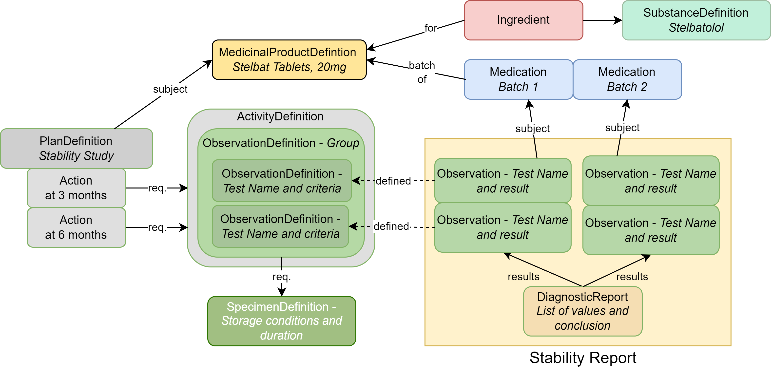
Stability Study Profile Template

Slide 7
Overview of the Stability Study Profile Template
Objective
Provides details about a stability study that includes test, test criteria, test results, and the batches of medicinal product subject to testing.
Profile Components
Medicinal Product Definition: The drug product (Stelbat tablets, 20mg)
Ingredient: The API (stelbatalol) or the ingredients that make up the DP
Substance Definition: Chemical or biological details about substance(s) associated with the API (molecular weight, molecular formula, stereochemistry, protein or nucleic acid subunits)
Medication: Describes the batches that underwent stability testing
Plan Definition: Describes the stability study protocol
Activity Definition: Contains the Observation Definition resources that establish the list of tests and their acceptance criteria
Observation Definition: Each individual stability test and their acceptance criteria. Also used to group tests
Observation: The results of a specific test mentioned in the Observation Definition
Specimen Definition: Describes the storage conditions and duration for each test
Diagnostic Report: Contains all rest results as a group and captures conclusions.

Slide 8
Step by step process to build the stability study Profile Template
1
2
3
Select Ingredients
Select Substances
Select Medicinal Product
Select individual tests and acceptance criteria
Select storage conditions
Populate stability study details
Select Batch references
Populate test results
Populate final report with conclusions
7
6
8
4
5
9
Notes:
Dependent on the system setup, it is possible to select the medicinal product (#3) and have ingredients (#2) and substances (#1) auto-populated. Could also auto-filter batch information for a given medicinal product.
Tests, acceptance criteria, storage conditions would be prepopulated.

Slide 9
Profile Template: Drug Product Specification

Slide 10
Drug Product Specification Profile Template

Slide 11
Overview of the Drug Product Specification Profile Template
Objective
Provides details about a stability study that includes test, test criteria, test results, and the batches of medicinal product subject to testing.
Profile Components
Medicinal Product Definition: The drug product (Stelbat tablets, 20mg)
Ingredient: The API (stelbatalol) or the ingredients that make up the DP
Substance Definition: Chemical or biological details about substance(s) associated with the API (molecular weight, molecular formula, stereochemistry, protein or nucleic acid subunits)
Plan Definition: Title and narrative description of the DP specification
Observation Definition: Each individual test procedure, its acceptance criteria, and method reference

Slide 12
Step-by-step Process to Create a Drug Product Specification
3
1
2
Select Ingredients
Select Substances
Select Medicinal Product
Populate test procedure
Populate methods
Populate DP specification details
6
4
5
Notes:
Dependent on the system setup, it is possible to select the medicinal product (#3) and have ingredients (#2) and substances (#1) auto-populated.
As with medicinal product, it is possible to create a library of tests. Selecting a test could automatically pull in associated acceptance criteria and methods.

Slide 13
Profile Template: Manufacturing Process Description

Slide 14
Manufacturing Process Profile Template

Slide 15
Overview of the Manufacturing Process Profile Template
Objective
Provides details on manufacturing process steps, parameters, materials, and unit operations for a given substance
Profile Components
MedicinalProductDefinition: The drug product (Stelbat tablets, 20mg)
Ingredient: The component of the DP that is being manufactured (in this case, it is the API – stelbatalol)
Substance Definition: The drug substance components that the manufacturing steps are being performed on (Stelbatalol, starting materials, intermediates)
PlanDefinition: Describes the manufacturing process steps (Step 1, Mixing; Step N, Drying), the operating parameters (vessel capacity, temperature), and defines the output of the tests being performed (pH, water content)
DeviceDefinition: Describes the pieces of equipment that perform each manufacturing process step (Mixer, Dryer, Vessel)

Slide 16
Step-by-step Process to Create a Data Package for Manufacturing Process
1
1. Select MedicinalProductDefinition resource for “Stelbat Tablets”
2. Select Ingredient Role “active” for the Substance “Stelbatalol”
3. Populate starting/intermediate substance materials using SubstanceDefinition
4. Populate the manufacturing process steps, equipment, and parameters using PlanDefinition and DeviceDefinition resources for the corresponding Substances
2
4
3

Slide 17
Profile Template: Process Validation

Slide 18
How to build a Process Validation Profile Template

Slide 19
Overview of the Process Validation Profile Template
Objective
Provides details and results for validation testing of the manufacturing process steps
Profile Components
MedicinalProductDefinition: The drug product (Stelbat tablets, 20mg)
Ingredient: The component of the DP that is being manufactured (in this case, it is the API – stelbatalol)
Substance Definition: The drug substance components that the manufacturing steps are being performed on (Stelbatalol)
PlanDefinition: Describes the manufacturing process steps that are being validated (Step 1, Mixing; Step N, Drying)
ActivityDefinition: Contains the ObservationDefinition resources that establish the list of tests and their acceptance criteria
DiagnosticReport: The collection of results of the process validation testing, including conclusion
ObservationDefinition: Each individual process validation test and result (ex. Appearance – White to Off-white powder)
Medication: Describes the batches that underwent process validation testing
Links to steps
defined under
Manufacturing Process profile

Slide 20
Step-by-step Process to Create a Data Package for Manufacturing Process
2
1
3
4
5
1. Select MedicinalProductDefinition resource for “Stelbat Tablets”
2. Select Ingredient Role “active” for the Substance “Stelbatalol”
3. Select the manufacturing steps under PlanDefinition that are being tested
4. Using ActivityDefinition and ObservationDefinition, populate the tests being conducted, their criteria, and the result.
5. Collate tests and results into process validation report.

